Slide 1
HTML5&CSS3 Day1 presented by: Asmaa Ahmed

Slide 2
What is XHTML?
XHTML stands for “Extensible HyperText Mark-up Language”.
XHTML is a new and more well-structured way of writing HTML. 
XHTML Versions : XHTML 1.0 became a W3C on January 26, 2000.
XHTML 1.1 became a W3C on May 31, 2001. 
XHTML5 is undergoing development as of September 2009, as part of the HTML5 specification. 
XHTML consists of all the elements in HTML 4.01, combined with the strict syntax of XML.

Slide 3
What’s New in XHTML?
The Most Important Differences :
XHTML documents must have one root element.
XHTML elements must be properly nested.
XHTML elements must always be closed even empty elements.
XHTML elements must be in lowercase.
Attribute names must be in lower case.
Attribute values must be quoted.
Attribute minimization is forbidden. e.g. checked="checked".
The id attribute replaces the name attribute.
The XHTML DTD defines mandatory elements. i.e. Is Mandatory

Slide 4
The Meaning of <!DOCTYPE html>
The very first line in every web document should contain a <!DOCTYPE html> declaration. Even though it's wrapped in angle brackets, it is not a tag but a statement.
Doctype stands for Document Type Declaration. It informs the web browser about the type and version of HTML used in building the web document. This helps the browser to handle and load it properly.
While the HTML syntax for this statement is somewhat simple, you must note each version of HTML has its own rules.

Slide 5
Read more about <!DOCTYPE html>
https://www.bitdegree.org/learn/doctype-html

Slide 6
What’s HTML 5?
HTML5 will be the new standard for HTML.
The previous version of HTML, HTML 4.01, came in 1999.
The web has changed a lot since then. 
HTML5 is still a work in progress.
However, the major browsers support many of the new HTML5 elements and APIs.

Slide 7
What’s HTML 5?
Some rules for HTML5 were established: 
New features should be based on HTML, CSS, DOM, and JavaScript.  Reduce the need for external plugins (like Flash) .
Better error handling. 
More markup to replace scripting .
The development process should be visible to the public.

Slide 8
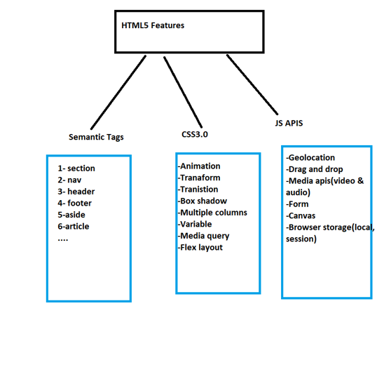
What’s HTML 5 Features?

Slide 9
HTML5 Elements
To better handle today's internet use, HTML5 also includes new elements for better structure, better form handling, drawing, and for media content.
https://www.tutorialrepublic.com/html-reference/html5-tags.php

Slide 10
HTML charset Attribute
To display an HTML page correctly, a web browser must know the character set used in the page. 
Available charsets:
❑ ASCII was the first character encoding standard (also called character set). It defines 127 different alphanumeric characters that could be used on the internet.  ASCII supported numbers (0-9), English letters (A-Z), and some special characters like ! $ + - ( ) @ < > . 
ANSI (Windows-1252) was the original Windows character set. It supported 256 different character codes. 
ISO-8859-1 was the default character set for HTML 4. It also supported 256 different character codes.
Notes:
H

Slide 11
HTML charset Attribute
Because ANSI and ISO was limited, the default character encoding was changed to UTF-8 in HTML5. 
UTF-8 (Unicode) covers almost all of the characters and symbols in the world
More Details: https://www.w3schools.com/html/html_charset.asp
Notes:
H

Slide 12
Viewport
What is The Viewport?
The viewport is the user's visible area of a web page.
The viewport varies with the device, and will be smaller on a mobile phone than on a computer screen.
Before tablets and mobile phones, web pages were designed only for computer screens, and it was common for web pages to have a static design and a fixed size.
Then, when we started surfing the internet using tablets and mobile phones, fixed size web pages were too large to fit the viewport. To fix this, browsers on those devices scaled down the entire web page to fit the screen.
This was not perfect!! But a quick fix.

Slide 13
Viewport
Setting The Viewport:
HTML5 introduced a method to let web designers take control over the viewport, through the <meta> tag.
You should include the following <meta> viewport element in all your web pages:
<meta name="viewport" content="width=device-width, initial-scale=1.0">
This gives the browser instructions on how to control the page's dimensions and scaling.
The width=device-width part sets the width of the page to follow the screen-width of the device (which will vary depending on the device).
The initial-scale=1.0 part sets the initial zoom level when the page is first loaded by the browser.

Slide 14
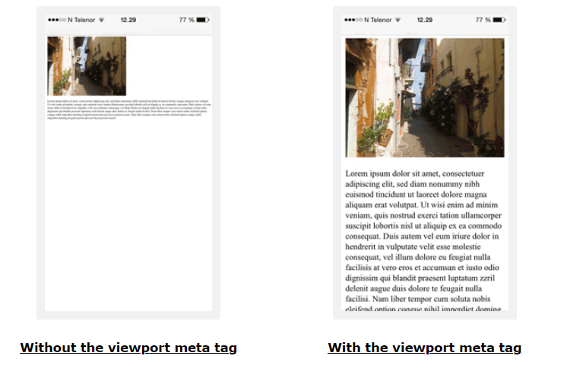
Viewport

Slide 15
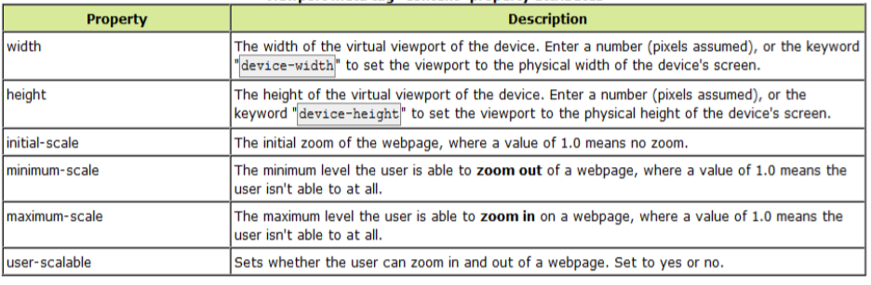
Viewport

Slide 16
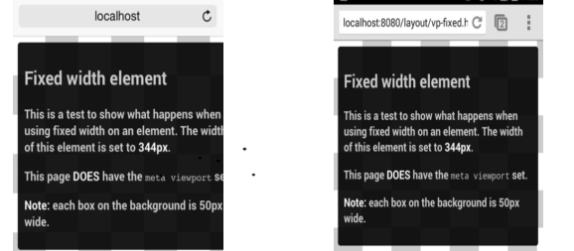
Size Content to The Viewport

Slide 17
HTML 5 Semantic & Structural Elements
Semantic Means:
When people say they want to make something more semantic, they simply want to make that thing more meaningful.
Semantic html is using html to reinforce structural meaning. It’s about using tags, class names, and ids that reinforce the meaning of the content within the tags.
Notes:
H

Slide 18
HTML 5 Semantic & Structural Elements
Why Semantic HTML is Important :
Clean : It’s easier to read and edit, which saves time and money during maintenance.
More accessible : It can be better understood by a greater variety of devices.
Search engine friendly : This is still debatable as search engines rank content and not code.
Notes:
H

Slide 19
HTML 5 Semantic & Structural Elements
Some New semantic Elements in HTML 5:
Meter
Progress
Mark
Time
<header>
<nav>
<section>
<article>
<hgroup>
<aside>
<footer>
<address>
Notes:
H

Slide 20
Forms
Form Controls
HTML 4 controls are too limited
Several new types added
New Input type
color
date
datetime
datetime-local
time
month
url
week
Datalist
email
number
range
search
tel
Notes:
H

Slide 21
Multimedia
No need for plugin to play video and audio HTML 5 will do it for you.
Video & Audio
HTML5 offers the ability to easily embed media into HTML documents.
Media playback can be controlled via JavaScript and media events.
Nothing to install.
Works in all browsers and phones (adding native support to browsers)
Notes:
H

Slide 22
Native Media format for HTML5
Video
webM
H.264(mp4)
oggTheora
Audio
wav
mp3
oogVorbi
Notes:
H

Slide 23
Native Media format for HTML5
No common format to use.
We have to encode in different multiple formats.
Need of converter to convert into different format.
Notes:
H

Slide 24
Media Attributes
Attribute | Value | Description
autoplay | autoplay | Specifies that the video will start playing as soon as it is ready
controls | controls | Specifies that video controls should be displayed (such as a play/pause button etc).
height | pixels | Sets the height of the video player
loop | loop | Specifies that the video will start over again, every time it is finished
muted | muted | Specifies that the audio output of the video should be muted
poster | URL | Specifies an image to be shown while the video is downloading, or until the user hits the play button
preload | auto metadata none | Specifies if and how the author thinks the video should be loaded when the page loads
src | URL | Specifies the URL of the video file
width | pixels | Sets the width of the video player
Notes:
H

Slide 25
Drag and drop
Event | On Event Handler | Fires when…
drag | ondrag | …a dragged item (element or text selection) is dragged.
dragend | ondragend | …a drag operation ends (such as releasing a mouse button or hitting the Esc key; see Finishing a Drag.)
dragenter | ondragenter | …a dragged item enters a valid drop target. (See Specifying Drop Targets.)
dragleave | ondragleave | …a dragged item leaves a valid drop target.
dragover | ondragover | …a dragged item is being dragged over a valid drop target, every few hundred milliseconds.
dragstart | ondragstart | …the user starts dragging an item. (See Starting a Drag Operation.)
drop | ondrop | …an item is dropped on a valid drop target. (See Performing a Drop.)
Notes:
H

Slide 26
Thanks!
Any questions?

